Slide 1


AN INTRODUCTION TO ORGANIC CHEMISTRY
A guide for A level students
KNOCKHARDY PUBLISHING

Slide 2
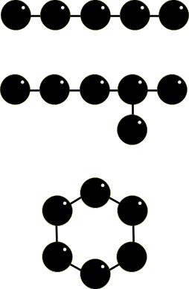
THE SPECIAL NATURE OF CARBON
CHAINS AND RINGS
CARBON ATOMS CAN BE ARRANGED IN
STRAIGHT CHAINS
BRANCHED CHAINS
and RINGS
You can also get a combination of rings and chains
CONTENTS

Slide 3
THE SPECIAL NATURE OF CARBON
MULTIPLE BONDING AND SUBSTITUENTS
CARBON-CARBON COVALENT BONDS CAN BE SINGLE, DOUBLE OR TRIPLE
CONTENTS

Slide 4

THE SPECIAL NATURE OF CARBON
MULTIPLE BONDING AND SUBSTITUENTS
CARBON-CARBON COVALENT BONDS CAN BE SINGLE, DOUBLE OR TRIPLE
DIFFERENT ATOMS / GROUPS OF ATOMS CAN BE PLACED ON THE CARBONS
The basic atom is HYDROGEN but groups containing OXYGEN, NITROGEN, HALOGENS and SULPHUR are very common.
CARBON SKELETON FUNCTIONAL CARBON SKELETON FUNCTIONAL
GROUP GROUP
The chemistry of an organic compound is determined by its FUNCTIONAL GROUP
CONTENTS

Slide 5


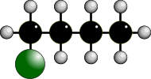

THE SPECIAL NATURE OF CARBON
MULTIPLE BONDING AND SUBSTITUENTS
ATOMS/GROUPS CAN BE PLACED IN DIFFERENT POSITIONS ON A CARBON SKELETON
THE C=C DOUBLE BOND IS IN A DIFFERENT POSITION
PENT-1-ENE PENT-2-ENE
THE CHLORINE ATOM IS IN A DIFFERENT POSITION
1-CHLOROBUTANE 2-CHLOROBUTANE
CONTENTS

Slide 6
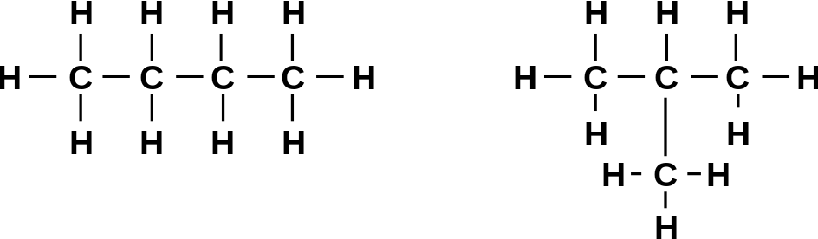
TYPES OF FORMULAE - 1
MOLECULAR FORMULA C₄H₁₀
The exact number of atoms of each
element present in the molecule
EMPIRICAL FORMULA C₂H₅
The simplest whole number ratio
of atoms in the molecule
STRUCTURAL FORMULA CH₃CH₂CH₂CH₃ CH₃CH(CH₃)CH₃
The minimal detail using conventional
groups, for an unambiguous structure there are two possible structures
DISPLAYED FORMULA
Shows both the relative placing of atoms
and the number of bonds between them
THE EXAMPLE BEING USED IS... BUTANE
CONTENTS

Slide 7
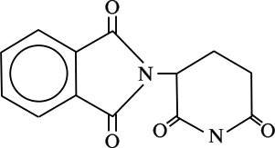
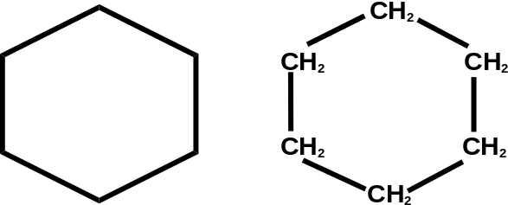
TYPES OF FORMULAE - 2
SKELETAL FORMULA
A skeletal formula is used to show a simplified organic formula by removing hydrogen atoms from alkyl chains, leaving just a carbon skeleton and associated functional groups
for
CYCLOHEXANE
THALIDOMIDE
CONTENTS

Slide 8
TYPES OF FORMULAE - 2
SKELETAL FORMULA
A skeletal formula is used to show a simplified organic formula by removing hydrogen atoms from alkyl chains, leaving just a carbon skeleton and associated functional groups
GENERAL FORMULA
Represents any member of for alkanes it is... C_{n}H_{2n+2}
a homologous series possible formulae... CH₄, C₂H₆ .... C₉₉H₂₀₀
The formula does not apply to cyclic compounds such as cyclohexane is C₆H₁₂
- by joining the atoms in a ring you need fewer H’s
for
CYCLOHEXANE
THALIDOMIDE
CONTENTS

Slide 9
FUNCTIONAL GROUPS
Organic chemistry is a vast subject so it is easier to split it into small sections for study. This is done by studying compounds which behave in a similar way because they have a particular atom, or group of atoms, FUNCTIONAL GROUP, in their structure.
Functional groups can consist of one atom, a group of atoms or multiple bonds between carbon atoms.
Each functional group has its own distinctive properties which means that the properties of a compound are governed by the functional group(s) in it.
H H H H H
H C C C C C NH₂
H H H H H
H H H H H
H C C C C C OH
H H H H H
Carbon Functional Carbon Functional
skeleton Group = AMINE skeleton Group = ALCOHOL
CONTENTS

Slide 10
COMMON FUNCTIONAL GROUPS
GROUP ENDING GENERAL FORMULA EXAMPLE
ALKANE - ane RH C₂H₆ ethane
ALKENE - ene C₂H₄ ethene
ALKYNE - yne C₂H₂ ethyne
HALOALKANE halo - RX C₂H₅Cl chloroethane
ALCOHOL - ol ROH C₂H₅OH ethanol
ALDEHYDE -al RCHO CH₃CHO ethanal
KETONE - one RCOR CH₃COCH₃ propanone
CARBOXYLIC ACID - oic acid RCOOH CH₃COOH ethanoic acid
ACYL CHLORIDE - oyl chloride RCOCl CH₃COCl ethanoyl chloride
AMIDE - amide RCONH₂ CH₃CONH₂ ethanamide
ESTER - yl - oate RCOOR CH₃COOCH₃ methyl ethanoate
NITRILE - nitrile RCN CH₃CN ethanenitrile
AMINE - amine RNH₂ CH₃NH₂ methylamine
NITRO nitro- RNO₂ CH₃NO₂ nitromethane
SULPHONIC ACID - sulphonic acid RSO₃H C₆H₅SO₃H benzene sulphonic acid
ETHER - oxy - ane ROR C₂H₅OC₂H₅ ethoxyethane
CONTENTS

Slide 11
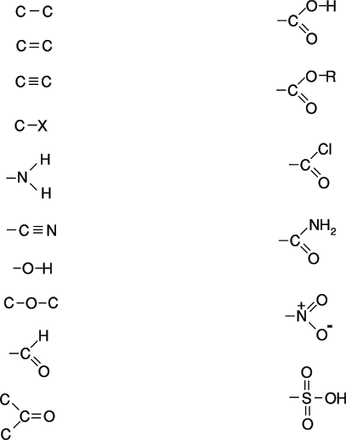
COMMON FUNCTIONAL GROUPS
ALKANE
ALKENE
ALKYNE
HALOALKANE
AMINE
NITRILE
ALCOHOL
ETHER
ALDEHYDE
KETONE
CARBOXYLIC ACID
ESTER
ACYL CHLORIDE
AMIDE
NITRO
SULPHONIC ACID
CONTENTS

Slide 12


HOW MANY STRUCTURES?
Draw legitimate structures for each molecular formula and classify each one according to the functional group present. Not all the structures represent stable compounds.
carbon atoms have 4 covalent bonds surrounding them
oxygen atoms 2
nitrogen atoms 3
hydrogen 1
halogen atoms 1
C₂H₆ ONE
C₃H₉Br TWO
C₄H₈ FIVE - 3 with C=C and 2 ring compounds with all C-C’s
C₂H₆O TWO - 1 with C-O-C and 1 with C-O-H
C₃H₆O SIX - 2 with C=O, 2 with C=C and 2 with rings
C₂H₇N TWO
C₂H₄O₂ SEVERAL - Only 2 are stable
C₂H₃N TWO
CONTENTS

Slide 13
HOW MANY STRUCTURES?
Draw legitimate structures for each molecular formula and classify each one according to the functional group present. Not all the structures represent stable compounds.
carbon atoms have 4 covalent bonds surrounding them
oxygen atoms 2
nitrogen atoms 3
hydrogen 1
halogen atoms 1
C₂H₆ ONE
C₃H₉Br TWO
C₄H₈ FIVE - 3 with C=C and 2 ring compounds with all C-C’s
C₂H₆O TWO - 1 with C-O-C and 1 with C-O-H
C₃H₆O SIX - 2 with C=O, 2 with C=C and 2 with rings
C₂H₇N TWO
C₂H₄O₂ SEVERAL - Only 2 are stable
C₂H₃N TWO
CONTENTS

Slide 14
I.U.P.A.C. NOMENCLATURE
How long is a chain?
Because organic molecules are three dimensional and paper is two dimensional it can confusing when comparing molecules. This is because...
1. It is too complicated to draw molecules with the correct bond angles
2. Single covalent bonds are free to rotate
All the following written structures are of the same molecule - PENTANE C₅H₁₂
CH₃
CH₃
CH₂
CH₂
CH₂
CH₃
CH₂
CH₂
CH₂
CH₃
CH₃
CH₂
CH₂
CH₂
CH₃
CH₂
CH₃
CH₃
CH₂
CH₂
A simple way to check is to run a finger along the chain and see how many carbon atoms can be covered without reversing direction or taking the finger off the page. In all the above there are... FIVE CARBON ATOMS IN A LINE.
CONTENTS

Slide 15
I.U.P.A.C. NOMENCLATURE
How long is the longest chain?
Look at the structures and work out how many carbon atoms are in the longest chain.
CH₃
THE ANSWERS ARE
ON THE NEXT SLIDE
CH₂
CH₃
CH
CH₂
CH₃
CH₃
CH₃
CH₂
CH₂
CH₂
CH
CH₃
CH₃
CH₃
CH₂
CH₃
CH₂
CH
CH
CH₃
CONTENTS

Slide 16
I.U.P.A.C. NOMENCLATURE
How long is the longest chain?
Look at the structures and work out how many carbon atoms are in the longest chain.
CH₃
CH₂
LONGEST CHAIN = 5
CH₃
CH
CH₂
CH₃
CH₃
LONGEST CHAIN = 6
CH₃
CH₂
CH₂
CH₂
CH
CH₃
CH₃
CH₃
CH₂
LONGEST CHAIN = 6
CH₃
CH₂
CH
CH
CH₃
CONTENTS

Slide 17
I.U.P.A.C. NOMENCLATURE
A systematic name has two main parts.
SUFFIX An ending that tells you which functional group is present
See if any functional groups are present.
Add relevant ending to the basic stem.
In many cases the position of the functional group must be given to avoid any ambiguity
Functional group Suffix
ALKANE - ANE
ALKENE - ENE
ALKYNE - YNE
ALCOHOL - OL
ALDEHYDE - AL
KETONE - ONE
ACID - OIC ACID
1-CHLOROBUTANE 2-CHLOROBUTANE
SUBSTITUENTS Many compounds have substituents (additional atoms, or groups)
attached to the chain. Their position is numbered.
CONTENTS

Slide 18
I.U.P.A.C. NOMENCLATURE
SIDE-CHAIN carbon based substituents are named before the chain name.
they have the prefix -yl added to the basic stem (e.g. CH₃ is methyl).
Number the principal chain from one end to give the lowest numbers.
Side-chain names appear in alphabetical order butyl, ethyl, methyl, propyl
Each side-chain is given its own number.
If identical side-chains appear more than once, prefix with di, tri, tetra, penta, hexa
Numbers are separated from names by a HYPHEN e.g. 2-methylheptane
Numbers are separated from numbers by a COMMA e.g. 2,3-dimethylbutane
Alkyl radicals methyl CH₃ - CH₃
ethyl CH₃- CH₂- C₂H₅
propyl CH₃- CH₂- CH₂- C₃H₇
CONTENTS

Slide 19
I.U.P.A.C. NOMENCLATURE
SIDE-CHAIN carbon based substituents are named before the chain name.
they have the prefix -yl added to the basic stem (e.g. CH₃ is methyl).
Number the principal chain from one end to give the lowest numbers.
Side-chain names appear in alphabetical order butyl, ethyl, methyl, propyl
Each side-chain is given its own number.
If identical side-chains appear more than once, prefix with di, tri, tetra, penta, hexa
Numbers are separated from names by a HYPHEN e.g. 2-methylheptane
Numbers are separated from numbers by a COMMA e.g. 2,3-dimethylbutane
Example longest chain 8 (it is an octane)
3,4,6 are the numbers NOT 3,5,6
order is ethyl, methyl, propyl
3-ethyl-5-methyl-4-propyloctane
Alkyl radicals methyl CH₃ - CH₃
ethyl CH₃- CH₂- C₂H₅
propyl CH₃- CH₂- CH₂- C₃H₇
CH₃
CH₃
CH₃
CH₂
CH₂
CH
CH₂
CH₃
CH₂
CH₂
CH
CH
CH₂
CH₃
CONTENTS

Slide 20
I.U.P.A.C. NOMENCLATURE
I.U.P.A.C. NOMENCLATURE
Apply the rules and name these alkanes
CH₃
CH₂
CH₃
CH
CH₂
CH₃
CH₃
CH₃
CH₂
CH₂
CH₂
CH
CH₃
CH₃
CH₃
CH₂
CH₃
CH₂
CH
CH
CH₃
CONTENTS

Slide 21
I.U.P.A.C. NOMENCLATURE
I.U.P.A.C. NOMENCLATURE
Apply the rules and name these alkanes
CH₃
Longest chain = 5 so it is a pentane
A CH₃, methyl, group is attached to the third carbon from one end...
3-methylpentane
CH₂
CH₃
CH
CH₂
CH₃
CH₃
CH₃
CH₂
CH₂
CH₂
CH
CH₃
CH₃
CH₃
CH₂
CH₃
CH₂
CH
CH
CH₃
CONTENTS

Slide 22
I.U.P.A.C. NOMENCLATURE
I.U.P.A.C. NOMENCLATURE
Apply the rules and name these alkanes
CH₃
Longest chain = 5 so it is a pentane
A CH₃, methyl, group is attached to the third carbon from one end...
3-methylpentane
CH₂
CH₃
CH
CH₂
CH₃
CH₃
Longest chain = 6 so it is a hexane
A CH₃, methyl, group is attached to the second carbon from one end...
2-methylhexane
CH₃
CH₂
CH₂
CH₂
CH
CH₃
CH₃
CH₃
CH₂
CH₃
CH₂
CH
CH
CH₃
CONTENTS

Slide 23
I.U.P.A.C. NOMENCLATURE
I.U.P.A.C. NOMENCLATURE
Apply the rules and name these alkanes
CH₃
Longest chain = 5 so it is a pentane
A CH₃, methyl, group is attached to the third carbon from one end...
3-methylpentane
CH₂
CH₃
CH
CH₂
CH₃
CH₃
Longest chain = 6 so it is a hexane
A CH₃, methyl, group is attached to the second carbon from one end...
2-methylhexane
CH₃
CH₂
CH₂
CH₂
CH
CH₃
Longest chain = 6 so it is a hexane
CH₃, methyl, groups are attached to the third and fourth carbon atoms (whichever end you count from).
3,4-dimethylhexane
CH₃
CH₃
CH₂
CH₃
CH₂
CH
CH
CH₃
CONTENTS

Slide 24
NAMING ALKENES
Length In alkenes the principal chain is not always the longest chain
It must contain the double bond
the name ends in -ENE
Position Count from one end as with alkanes.
Indicated by the lower numbered carbon atom on one end of the C=C bond
5 4 3 2 1
CH₃CH₂CH=CHCH₃ is pent-2-ene (NOT pent-3-ene)
Side-chain Similar to alkanes
position is based on the number allocated to the double bond
1 2 3 4 1 2 3 4
CH₂ = CH(CH₃)CH₂CH₃ CH₂ = CHCH(CH₃)CH₃
2-methylbut-1-ene 3-methylbut-1-ene
CONTENTS

Slide 25
WHICH COMPOUND IS IT?
Elucidation of the structures of organic compounds - a brief summary
Organic chemistry is so vast that the identification of a compound can be involved. The characterisation takes place in a series of stages (see below). Relatively large amounts of substance were required to elucidate the structure but, with modern technology and the use of electronic instrumentation, very small amounts are now required.
Elemental composition
One assumes that organic compounds contain carbon and hydrogen but it can be proved by letting the compound undergo combustion. Carbon is converted to carbon dioxide and hydrogen is converted to water.
Percentage composition by mass
Found by dividing the mass of an element present by the mass of the compound present, then multiplying by 100. Elemental mass of C and H can be found by allowing the substance to undergo complete combustion. From this one can find...
mass of carbon = 12/44 of the mass of CO₂ produced
mass of hydrogen = 2/18 of the mass of H₂O produced
CONTENTS

Slide 26
INVESTIGATING MOLECULES
Empirical formula
The simplest ratio of elements present in the substance. It is calculated by dividing the mass or percentage mass of each element by its molar mass and finding the simplest ratio between the answers. Empirical formula is converted to the molecular formula using molecular mass.
CONTENTS

Slide 27
INVESTIGATING MOLECULES
Empirical formula
The simplest ratio of elements present in the substance. It is calculated by dividing the mass or percentage mass of each element by its molar mass and finding the simplest ratio between the answers. Empirical formula is converted to the molecular formula using molecular mass.
Molecular mass
Traditionally found out using a variety of techniques such as ... volumetric analysis or molar volume methods (Dumas, Victor-Meyer or gas syringe experiments). Mass spectrometry is now used. The m/z value of the molecular ion and gives the molecular mass. The fragmentation pattern gives information about the compound.
CONTENTS

Slide 28
INVESTIGATING MOLECULES
Empirical formula
The simplest ratio of elements present in the substance. It is calculated by dividing the mass or percentage mass of each element by its molar mass and finding the simplest ratio between the answers. Empirical formula is converted to the molecular formula using molecular mass.
Molecular mass
Traditionally found out using a variety of techniques such as ... volumetric analysis or molar volume methods (Dumas, Victor-Meyer or gas syringe experiments). Mass spectrometry is now used. The m/z value of the molecular ion and gives the molecular mass. The fragmentation pattern gives information about the compound.
Molecular formula
The molecular formula is an exact multiple of the empirical formula. Comparing the molecular mass with the empirical mass allows one to find the true formula. e.g.
if the empirical formula is CH (relative mass = 13) and the molecular mass is 78
the molecular formula will be 78/13 or 6 times the empirical formula i.e. C₆H₆ .
CONTENTS

Slide 29
INVESTIGATING MOLECULES
Empirical formula
The simplest ratio of elements present in the substance. It is calculated by dividing the mass or percentage mass of each element by its molar mass and finding the simplest ratio between the answers. Empirical formula is converted to the molecular formula using molecular mass.
Molecular mass
Traditionally found out using a variety of techniques such as ... volumetric analysis or molar volume methods (Dumas, Victor-Meyer or gas syringe experiments). Mass spectrometry is now used. The m/z value of the molecular ion and gives the molecular mass. The fragmentation pattern gives information about the compound.
Molecular formula
The molecular formula is an exact multiple of the empirical formula. Comparing the molecular mass with the empirical mass allows one to find the true formula. e.g.
if the empirical formula is CH (relative mass = 13) and the molecular mass is 78
the molecular formula will be 78/13 or 6 times the empirical formula i.e. C₆H₆ .
Structural formula
Because of the complexity of organic molecules, there can be more than one structure for a given molecular formula. To work out the structure, different tests are carried out.
CONTENTS

Slide 30
INVESTIGATING MOLECULES
Empirical formula
The simplest ratio of elements present in the substance. It is calculated by dividing the mass or percentage mass of each element by its molar mass and finding the simplest ratio between the answers. Empirical formula is converted to the molecular formula using molecular mass.
Molecular mass
Traditionally found out using a variety of techniques such as ... volumetric analysis or molar volume methods (Dumas, Victor-Meyer or gas syringe experiments). Mass spectrometry is now used. The m/z value of the molecular ion and gives the molecular mass. The fragmentation pattern gives information about the compound.
Molecular formula
The molecular formula is an exact multiple of the empirical formula. Comparing the molecular mass with the empirical mass allows one to find the true formula. e.g.
if the empirical formula is CH (relative mass = 13) and the molecular mass is 78
the molecular formula will be 78/13 or 6 times the empirical formula i.e. C₆H₆ .
Structural formula
Because of the complexity of organic molecules, there can be more than one structure for a given molecular formula. To work out the structure, different tests are carried out.
CONTENTS

Slide 31
INVESTIGATING MOLECULES
Chemical Chemical reactions can identify the functional group(s) present.
Spectroscopy IR detects bond types due to absorbance of i.r. radiation
NMR gives information about the position and relative
numbers of hydrogen atoms present in a molecule
Confirmation By comparison of IR or NMR spectra and
mass spectrometry
CONTENTS

